Slide 1
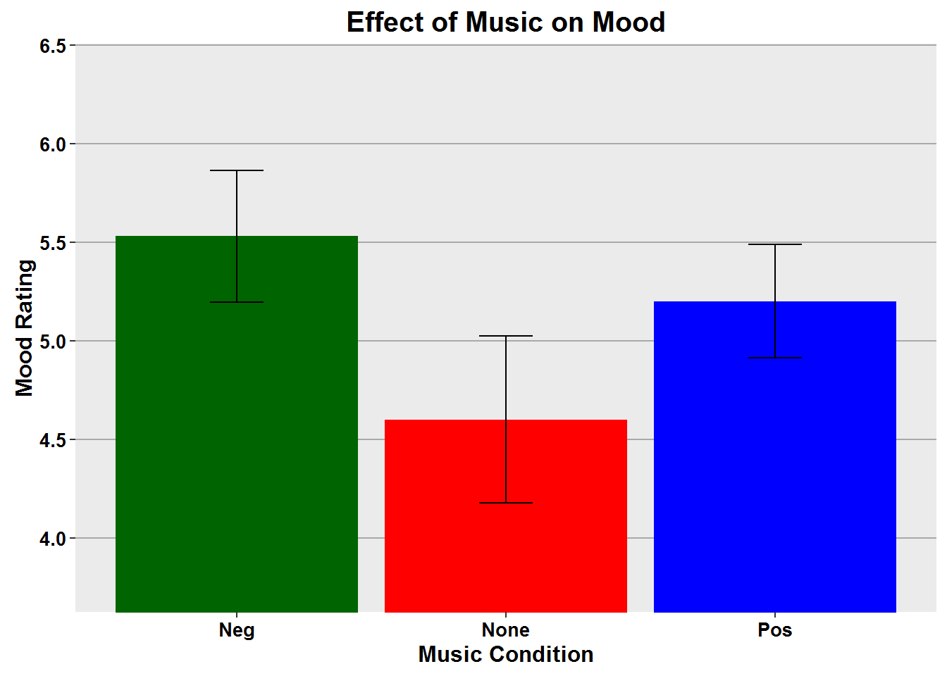
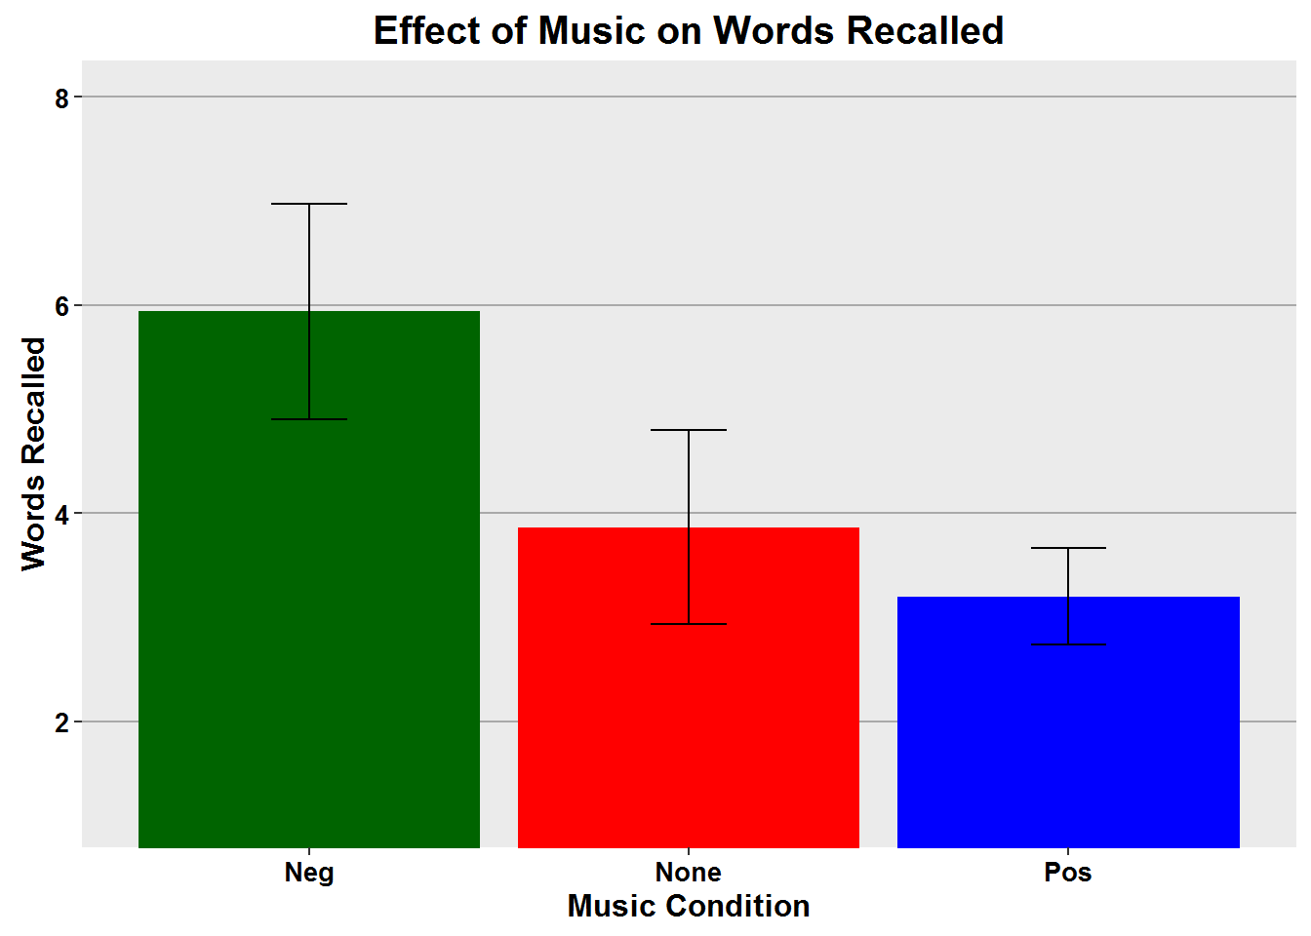
Effects of Music on Mood
Abstract
Introduction
Mood state at the time of encoding predicts better recall of mood congruent stimuli.
Mood altered by music may have
significant effects on
Cognition processes
Memory performance
Enhanced learning
The stronger the evidence that positive music is helpful, the greater the influence on choice of music over other forms of background noise.
Music may lead to improved memory performance by:
Maintaining a person's level of arousal during encoding and recall.
Forming part of an environmental context in which stimuli are encoded and retrieved.
To further investigate this environmental context and relationship of music on mood-dependent-memory tasks, we compared the effects of positive, negative, and no music on recall abilities.
Methods
Participants viewed a list of neutral words while listening to either no music (control group) or a minor key piece (negative) or major key piece (positive).
Participants rated their mood state after exposure to the word list.
Participants completed a short mathematical distractor task.
Participants were asked to recall as many words as possible.
Results
The music condition had no effect on the participants mood rating, F(2,49) = 1.7, p = .187
The music did however have an effect on the number of words recalled correctly, F(2,49) = 3.2, p = <.05
The two tailed t-test indicated there was significant effect between the Negative and Positive conditions, t = 2.5, df = 35, p = 0.015.
Discussion
The significant difference in words recalled was between the Negative and Positive conditions.
Results were opposite of what was hypothesized.
Mood as a function of the music condition, revealed no significant effect.
One weakness of the study was that it was conducted via Facebook, an environment that is accessed heavily with cell phones, however links to YouTube videos did not work on cell phones, iPads, or with the Chrome browser.
Each computer (IP address) only used once.
Data from 29 of the 81 participants were excluded from the analyses as incomplete.
Recommendations:
Conduct in a laboratory setting.
Controlled environment.
Increase the sample size.
Use different music for the Negative condition.
Summary
Previous research experiments showed:
An effect of music on mood.
Performance indicated memory is enhanced by positive mood.
In this experiment:
Data showed no significant effect of mood between the three music conditions.
The Negative condition had the best recall of words.
The Positive condition had the lowest recall.
References
Balch, W. R., Myers, D. M., & Papotto, C. (1999). Dimensions of mood in mood-dependent memory. Journal of Experimental Psychology: Learning, Memory, and Cognition, 25(1), 70-83. doi: 10.1037/0278-7393.25.1.70
Houston, D., & Haddock, G. (2007). On auditing auditory information: The influence of mood on memory for music. Psychology of Music, 35, 201-212. doi: 10.1177/0305735607070303
Palmiero, M., Nori, R., Rogolino, C., D’Amico, S., & Piccardi, L. (2015). Situated navigational working memory: The role of positive mood. Cognitive Processing, 16, 327-330. doi: 10.1007/s10339-015-0670-4
Salimpoor, V.N., Benovoy, M., Larcher, K., Dagher, A., & Zatorre, R.J. (2011). Anatomically distinct dopamine release during anticipating and experience of peak emotion to music. Nature Neuroscience, doi: 10.1038/nn.2726

